Slide 1
Artificial Intelligence
Project name:
Implementation of shortest path
problem using A* algorithm.
Dr Rupam Bhattacharyya
Course Instructor:-

Slide 2
Project Team members
Roushan Kumar 170101045
Vipul Kumar 170101054
Mukul Kumar 170101028
Rishabh Singh 170101044

Slide 3
What is Shortest path Problem?
The Shortest Path problem is used to find the shortest path between two cities on a map.c.In this project I am going to path finding problems, that is, planning routes from a start node to some goal nodes in a graph.Such problems arise in many fields of technology, for example, message routing in large networks, resource allocation and vehicle navigation systems.I concentrate mostly on planning a minimum cost path using the A∗ algorithm.
Algorithm used: A* algorithm

Slide 4
A* Algorithm
The A* Algorithm is a best-first search algorithm that finds the least cost path from an initial configuration
to a final configuration.The most essential part of the A* Algorithm is a good heuristic estimate function. This can improve the efficiency and performance of the algorithm.It is an extension of Dijkstra.s algorithm.A* algorithm uses the function.
f(n) = g(n) + h(n).
*f(n) is the estimated path cost
g(n) is the path-cost function, which is the cost from the starting node to the current node.
* h(n) is the heuristic estimate of the distance to the goal

Slide 5
Property of A* algorithm
Time ? The time complexity of A∗ depends on the heuristic.In the worst case, the number of nodes expanded is exponential in the length of the solution. |h(x) − h ∗ (x)| = O(log(h) ∗ (x));
Time complexity in our case=O(n^2)
Space ? O(n) - keeps all nodes in memory

Slide 6
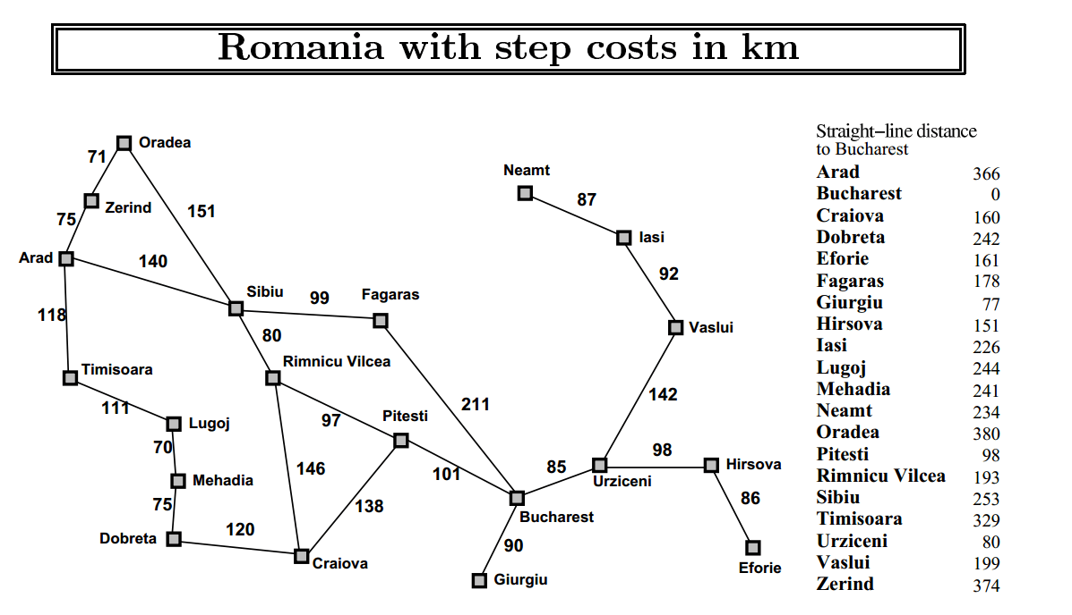

Slide 7
* FLOW CHART OF CODE EXECUTION *
START
(MAIN())
LOAD THE MAP DETAILS
(Romania_map_details())

Slide 8
PUT THE START CITY INTO OPEN AND ADD ALL THE SUCCESSOR OF START CITY IN OPEN AND SEND START INTO CLOSE
FIND THE NODE IN OPEN HAVING MINIMUM F(N) VALUE
IF CURRENT CITY==BUCHAREST
PUT ALL THE SUCCESOR INTO OPEN QUEUE
NO
CLOSED
QUEUE
CLOSED QUEUE
CURRENT CITY
YES
END

Slide 9
OUTPUT OF THE CODE BASED ON A GIVEN INPUT
enter the starting city name: Arad
loaded the map of Romania:
THE SHORTEST ROUTE TO BUCHAREST IS AS SHOWN BELOW
----->Arad------>Sibiu------->Rimnica Vilcea---------->Pitesti--------->Bucharest
Total Steps reqquired to find the shortest path: 4

Slide 10
CONCLUSION
We receive the optimal path in the map .
Apart from solving the shortest path problems using Dijkstra’s algorithm we can have optimum solution by using A* algorithm .

Slide 11
THANK YOU

